Slide 1


Streaming for Aibohphobes: Longest Near-Palindrome under Hamming Distance
Elena Grigorescu, Purdue University
Erfan Sadeqi Azer, Indiana University
Samson Zhou, Purdue University
Presenter: Akash Kumar, Purdue University

Slide 2
Structure of Talk
Background
1-Pass Additive Algorithm
2-Pass Exact Algorithm
Lower Bounds

Slide 3
Finding Structure in Noisy Data
FSTTCSIITKANPURPATTERNINDIAPALPPATTERNSZXAITIIKIICU JBFQWA
FSTTCSPATTERNIITKANPURINDIAO
STREAMINGALGORITHMPATTERNUPERIODPERIODPERIODPERIODPERFSTTCSTHEORYCSASBRICBCAUON
LONGPALINDROMEEMORDNILAPGNOLFSTTCSIITKANPURINDIAGENXAS

Slide 4



Palindrome
A string that reads the same forwards and backwards
$S=S^{R}$
RACECAR
RACECAR
AIBOHPHOBIA
AIBOHPHOBIA

Slide 5


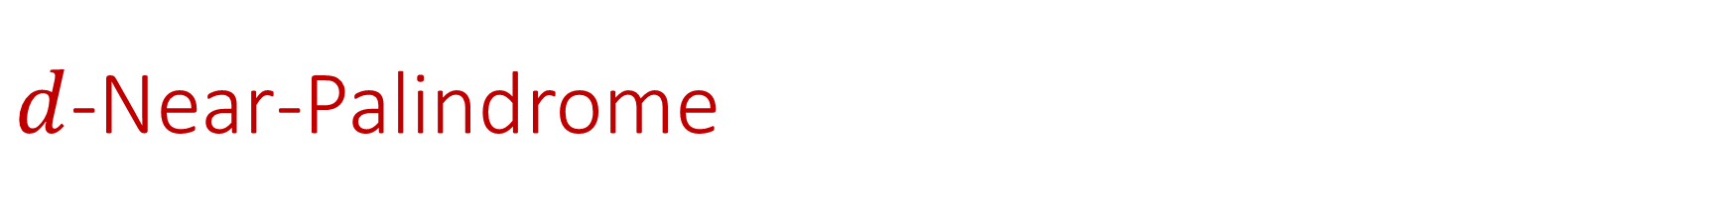
$d$-Near-Palindrome
A string that “almost” reads the same forwards and backwards
Given a metric $dist$, a $d$-near-palindrome has $dist\left(S,S^{R}\right)≤d$.
RACECAR
FACECAR

Slide 6
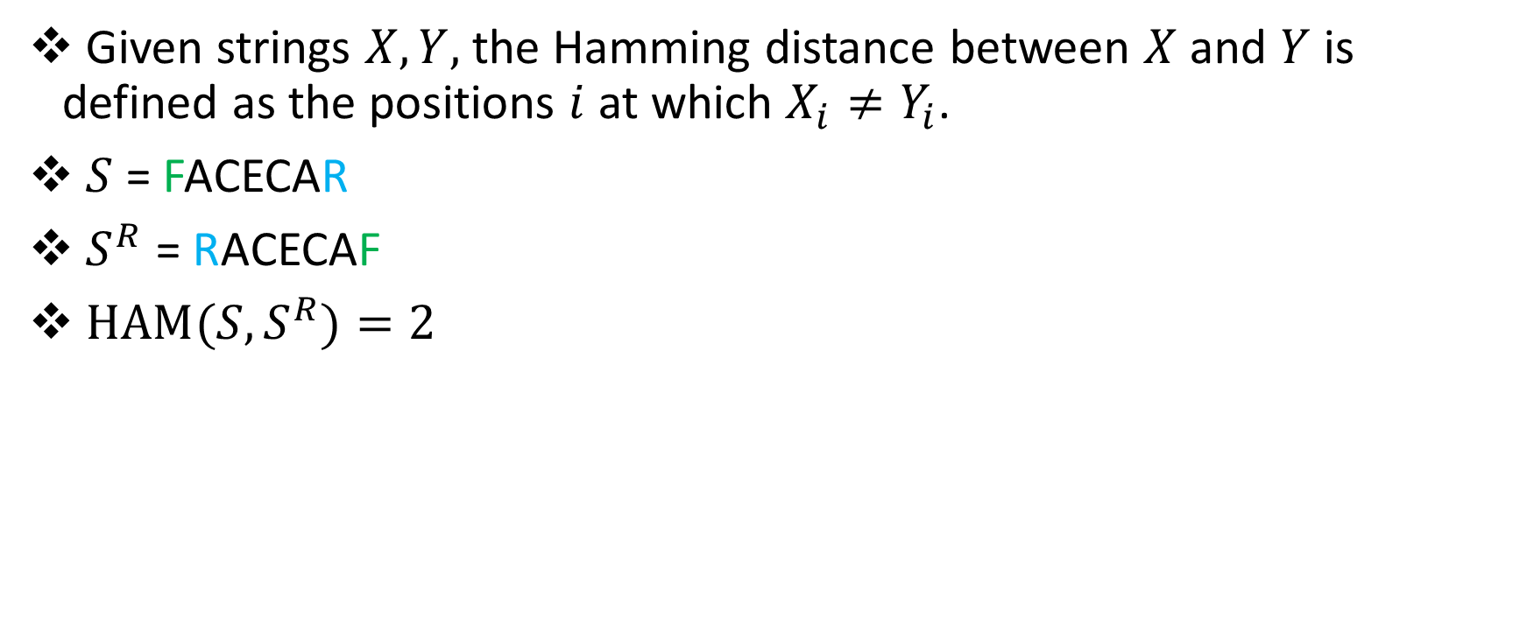
Hamming Distance
Given strings $X, Y,$ the Hamming distance between $X$and $Y$ is defined as the positions $i$ at which $X_{i}≠Y_{i}$.
$S$ = FACECAR
$S^{R}$ = RACECAF
${HAM(S,S}^{R})=2$

Slide 7

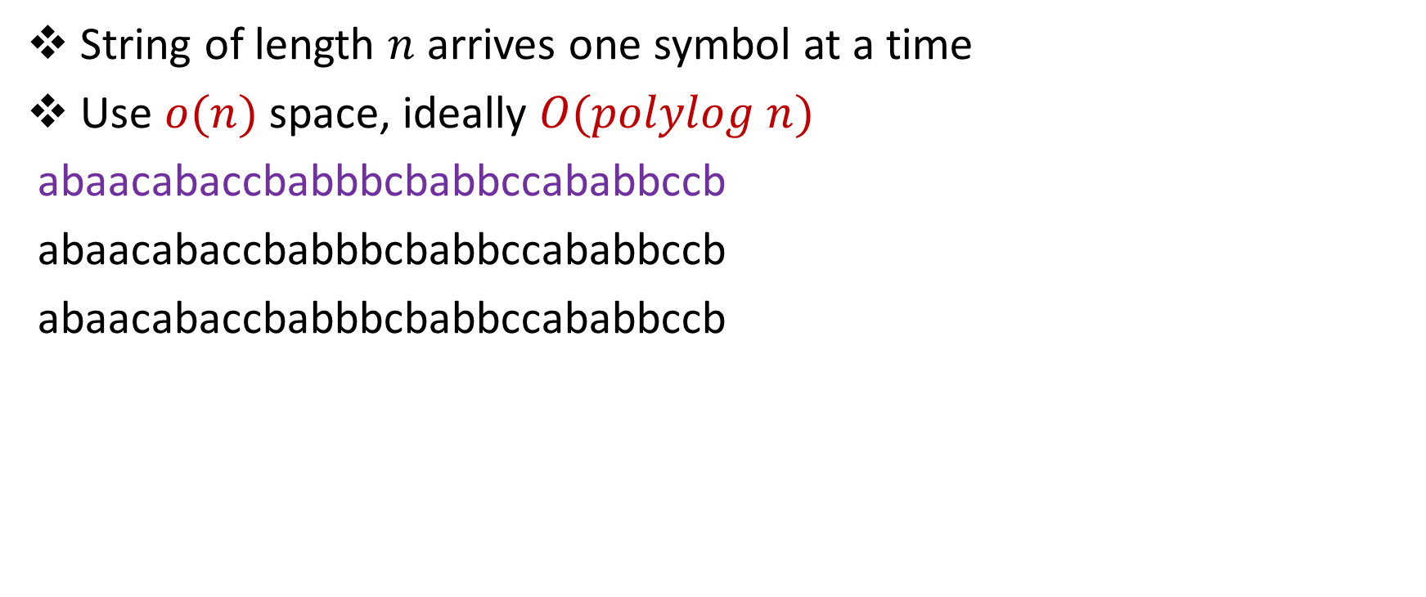
Streaming Model
String of length $n$ arrives one symbol at a time
Use $o(n)$ space, ideally $O(polylog n)$
abaacabaccbabbbcbabbccababbccb
abaacabaccbabbbcbabbccababbccb
abaacabaccbabbbcbabbccababbccb

Slide 8
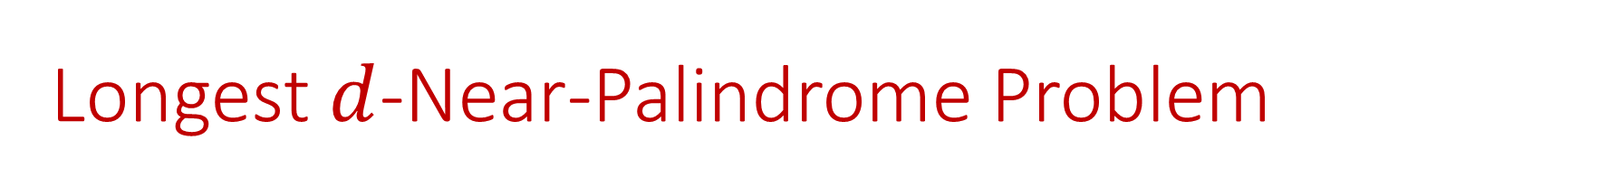
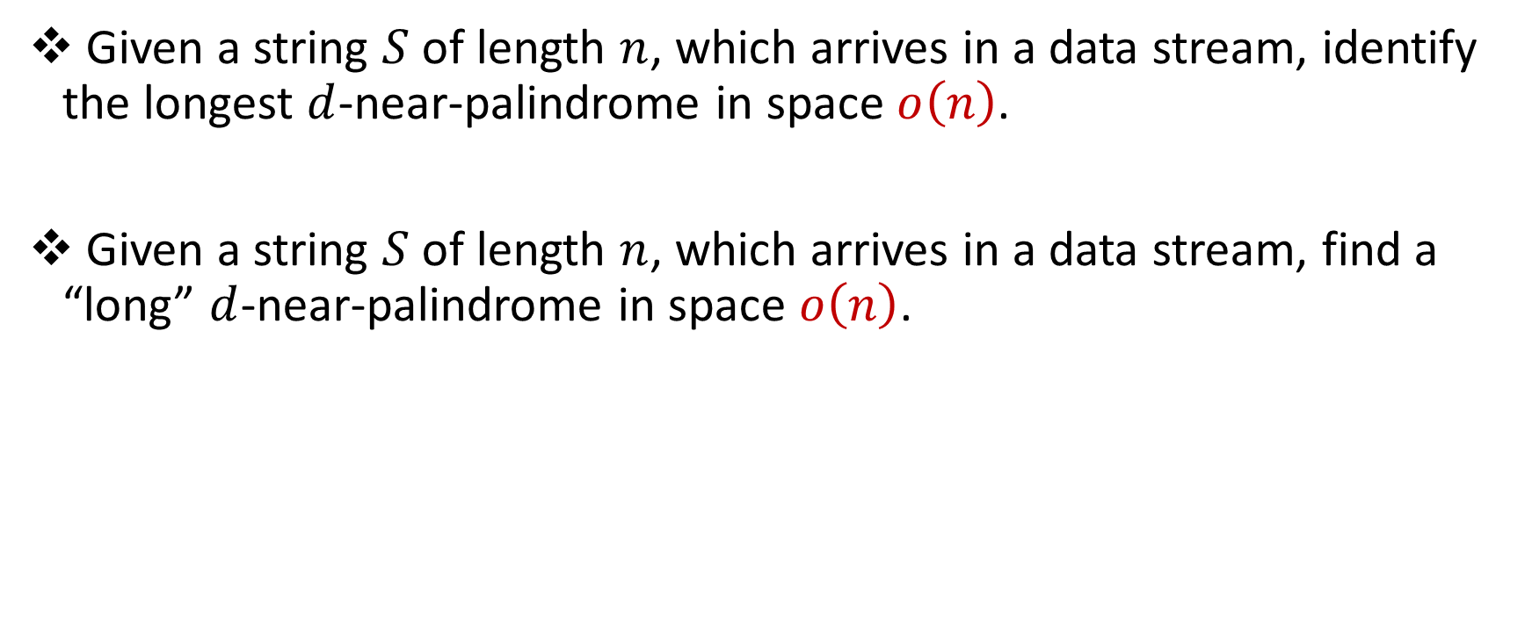
Longest $d$-Near-Palindrome Problem
Given a string $S$ of length $n$, which arrives in a data stream, identify the longest $d$-near-palindrome in space $o\left(n\right)$.
Given a string $S$ of length $n$, which arrives in a data stream, find a “long” $d$-near-palindrome in space $o\left(n\right)$.

Slide 9
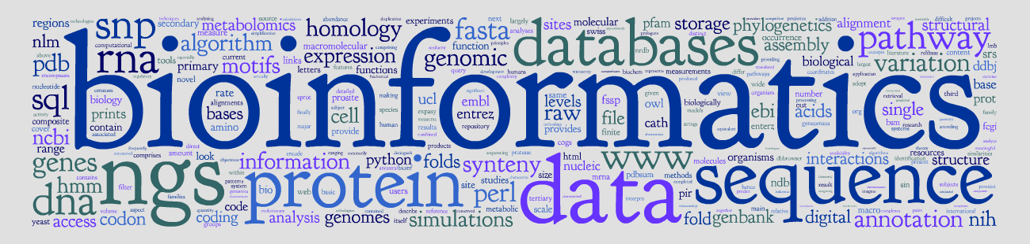
Applications
TGCTTAAGCGCTTGCAAGCGCTTAAGCA
CAAGCGCTTAAGCA
ACGAATTCGCGAAC

Slide 10
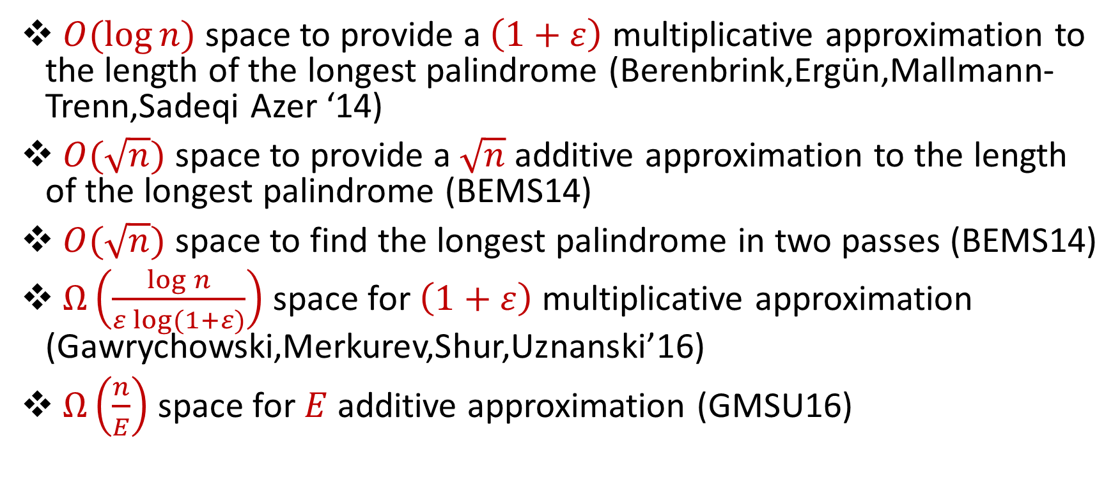
Related Work (Palindromes in Data Streams)
$O(\log{n)}$ space to provide a $\left(1+ε\right)$ multiplicative approximation to the length of the longest palindrome (Berenbrink,Ergün,Mallmann-Trenn,Sadeqi Azer ‘14)
$O(\sqrt{n})$ space to provide a $\sqrt{n}$ additive approximation to the length of the longest palindrome (BEMS14)
$O(\sqrt{n})$ space to find the longest palindrome in two passes (BEMS14)
$Ω\left(\frac{\log{n}}{ε log⁡(1+ε)}\right)$ space for $\left(1+ε\right)$ multiplicative approximation (Gawrychowski,Merkurev,Shur,Uznanski’16)
$Ω\left(\frac{n}{E}\right)$ space for $E$ additive approximation (GMSU16)

Slide 11
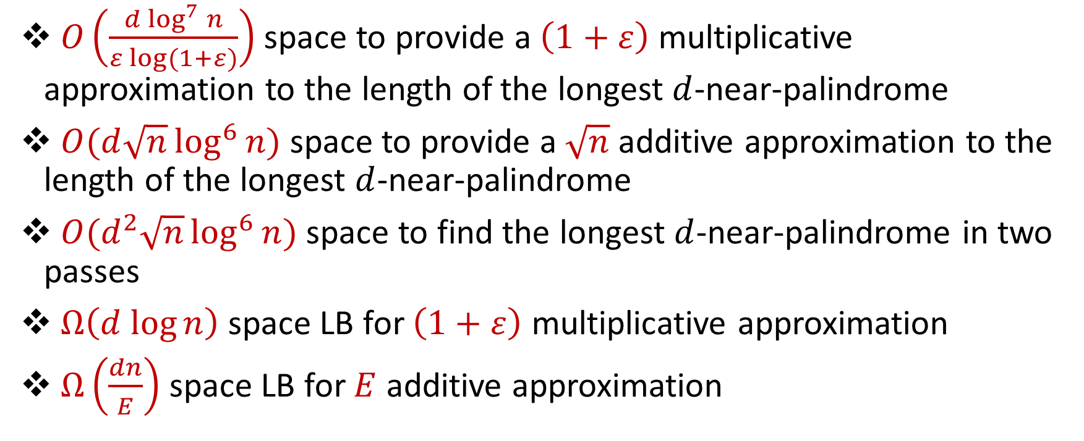
Our Results
$O\left(\frac{d \log^{7}{n}}{ε log⁡(1+ε)}\right)$ space to provide a $\left(1+ε\right)$ multiplicative approximation to the length of the longest $d$-near-palindrome
$O(d\sqrt{n}\log^{6}{n})$ space to provide a $\sqrt{n}$ additive approximation to the length of the longest $d$-near-palindrome
$O(d^{2}\sqrt{n}\log^{6}{n})$ space to find the longest $d$-near-palindrome in two passes
$Ω\left(d log{n}\right)$ space LB for $\left(1+ε\right)$ multiplicative approximation
$Ω\left(\frac{dn}{E}\right)$ space LB for $E$ additive approximation

Slide 12
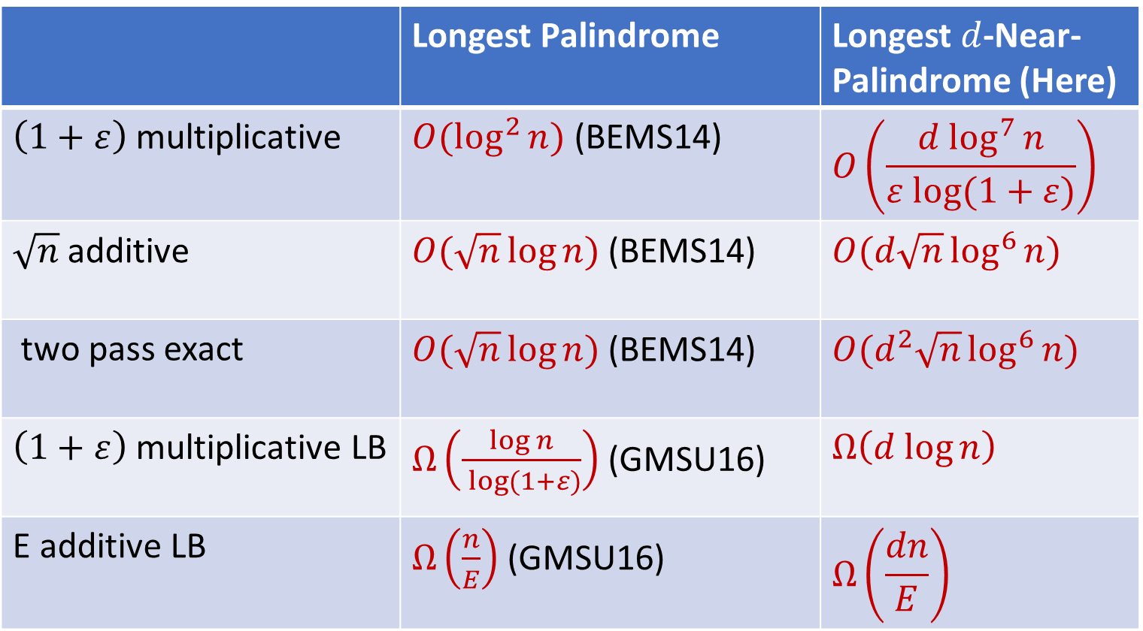
Comparison
 | Longest Palindrome | Longest $d$-Near-Palindrome (Here)
$\left(1+ε\right)$ multiplicative | $O(\log^{2}{n)}$ (BEMS14) | $$O\left(\frac{d \log^{7}{n}}{ε log⁡(1+ε)}\right)$$
$\sqrt{n}$ additive | $O(\sqrt{n}\log{n})$ (BEMS14) | $O(d\sqrt{n}\log^{6}{n})$
two pass exact | $O(\sqrt{n}\log{n})$ (BEMS14) | $O(d^{2}\sqrt{n}\log^{6}{n})$
$\left(1+ε\right)$ multiplicative LB | $Ω\left(\frac{\log{n}}{ log⁡(1+ε)}\right)$ (GMSU16) | $$Ω\left(d log{n}\right)$$
E additive LB | $Ω\left(\frac{n}{E}\right)$ (GMSU16) | $$Ω\left(\frac{dn}{E}\right)$$

Slide 13
Structure of Talk
Background
1-Pass Additive Algorithm
2-Pass Exact Algorithm
Lower Bounds

Slide 14


Warm-Up
Suppose we see string $S$, followed by string $T$. How can we determine if $S=T$, with high probability?

Slide 15


Karp-Rabin Fingerprints
Given base $B$and a prime $P$, define $φ\left(S\right)=\sum_{i=1}^{n}{B^{i}S\left[i\right] \left(mod P\right)}$
If $S=T$, then $φ\left(S\right)=φ\left(T\right)$
If $S≠T$, then $φ\left(S\right)≠φ\left(T\right)$ w.h.p. (Schwartz-Zippel)

Slide 16
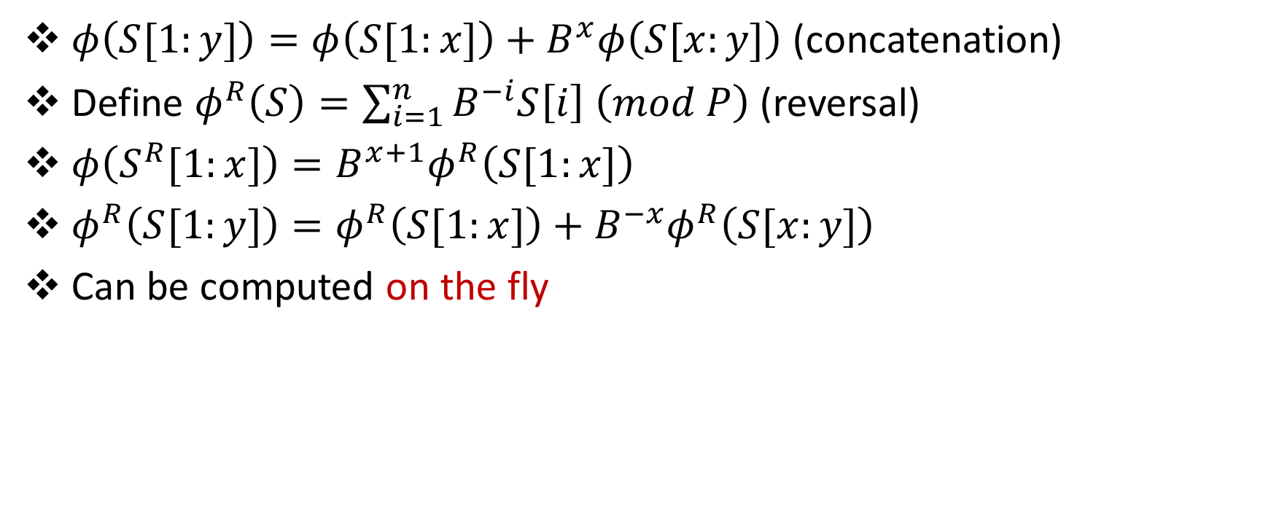
Properties of Karp-Rabin Fingerprints
$φ\left(S[1:y]\right)=φ\left(S[1:x]\right)+B^{x}φ\left(S[x:y]\right)$ (concatenation)
Define $φ^{R}\left(S\right)=\sum_{i=1}^{n}{B^{−i}S\left[i\right] \left(mod P\right)}$ (reversal)
$φ\left(S^{R}[1:x]\right)=B^{x+1}φ^{R}\left(S[1:x]\right)$
$φ^{R}\left(S[1:y]\right)=φ^{R}\left(S[1:x]\right)+B^{−x}φ^{R}\left(S[x:y]\right)$
Can be computed on the fly

Slide 17


Identifying Palindromes
111101011100001010010101001111101011100001010010101001
111101011100001010010101001111101011100001010010101001

Slide 18

Identifying Near-Palindromes?
111101011100001010010101001111101011100001010010101001
111101011100001010010101001111101011100001010010101001

Slide 19
Identifying Near-Palindromes?
111101011100001010010101001111101011100001010010101001
111101011100001010010101001111101011100001010010101001

Slide 20
Identifying Near-Palindromes?
111101011100001010010101001111101011100001010010101001
111101011100001010010101001111101011100001010010101001

Slide 21
Identifying Near-Palindromes?
111101011100001010010101001111101011100001010010101001
111101011100001010010101001111101011100001010010101001

Slide 22
Identifying Near-Palindromes?
111101011100001010010101001111101011100001010010101001
111101011100001010010101001111101011100001010010101001

Slide 23
Identifying Near-Palindromes? (CFP+16)
Notes:
To handle adversarial noise, we create fingerprints based on subpatterns instead of chunks. We sample a number of primes, and for each prime p that we choose, we create p subpatterns, partitioning the indices based on their congruence classes mod p. We then view each equivalence class as its own block, with a corresponding fingerprint. Ideally, by sampling a sufficient number of large primes, some prime will distribute the mismatches to separate subpatterns.

Slide 24
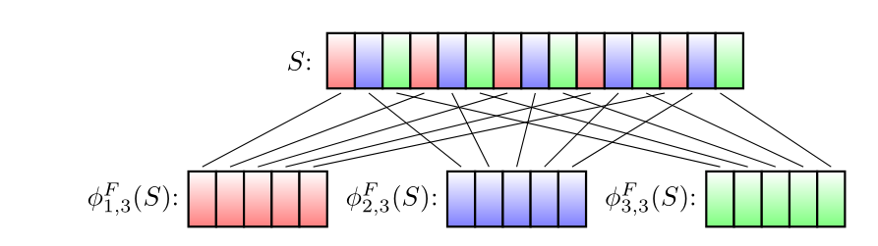

Karp-Rabin Fingerprints for Subpatterns
$S_{a,b}=S\left[a\right]S\left[a+b\right]S\left[a+2b\right]S\left[a+3b\right]…$
$φ_{a,b}\left(S\right)=φ\left(S_{a,b}\right)=B∗S\left[a\right]+B^{2}∗S\left[a+b\right]+B^{3}∗S\left[a+2b\right]…$

Slide 25

Identifying Near-Palindromes?
Let $∆ =\#\left\{a \right|{ φ}_{a,b}\left(S\right)≠{B^{k}φ}_{a,b}^{R}\left(S\right)\}$
Then $∆ ≤HAM(S,S^{R})$

Slide 26



Identifying Near-Palindromes?
What about
$HAM\left(S,S^{R}\right)≤2d$?
Sample $\log{n}$ primes $p_{1},p_{2},…$ from $\left[16 d\log^{2}{n, 544 d\log^{2}{n}}\right]$.
Let $∆ =max \#\left\{a \right|{ φ}_{a,p_{i}}\left(S\right)≠{B^{k}φ}_{a,p_{i}}^{R}\left(S\right)\}$
$∆ ≤HAM(S,S^{R})$
If $HAM\left(S,S^{R}\right)>2d$, then $∆ >\left(1+\frac{1}{16}\right)d$ w.h.p. (CFP+16)

Slide 27
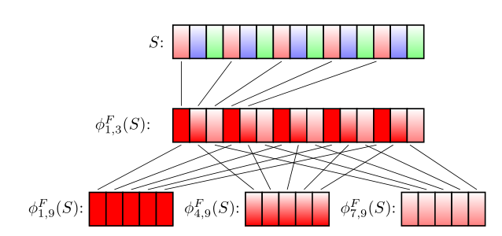
Karp-Rabin Fingerprints for Sub-Subpatterns

Slide 28


Second-Level Karp-Rabin Fingerprints
Call a mismatch isolated under $p_{i}$ if it is the only mismatch under some subpattern $S_{a,p_{i}}$. Let $I$ be the number of isolated mismatches.
If $HAM\left(S,S^{R}\right)≤2d$, then $I=HAM\left(S,S^{R}\right)$ w.h.p. (CFP+16)

Slide 29

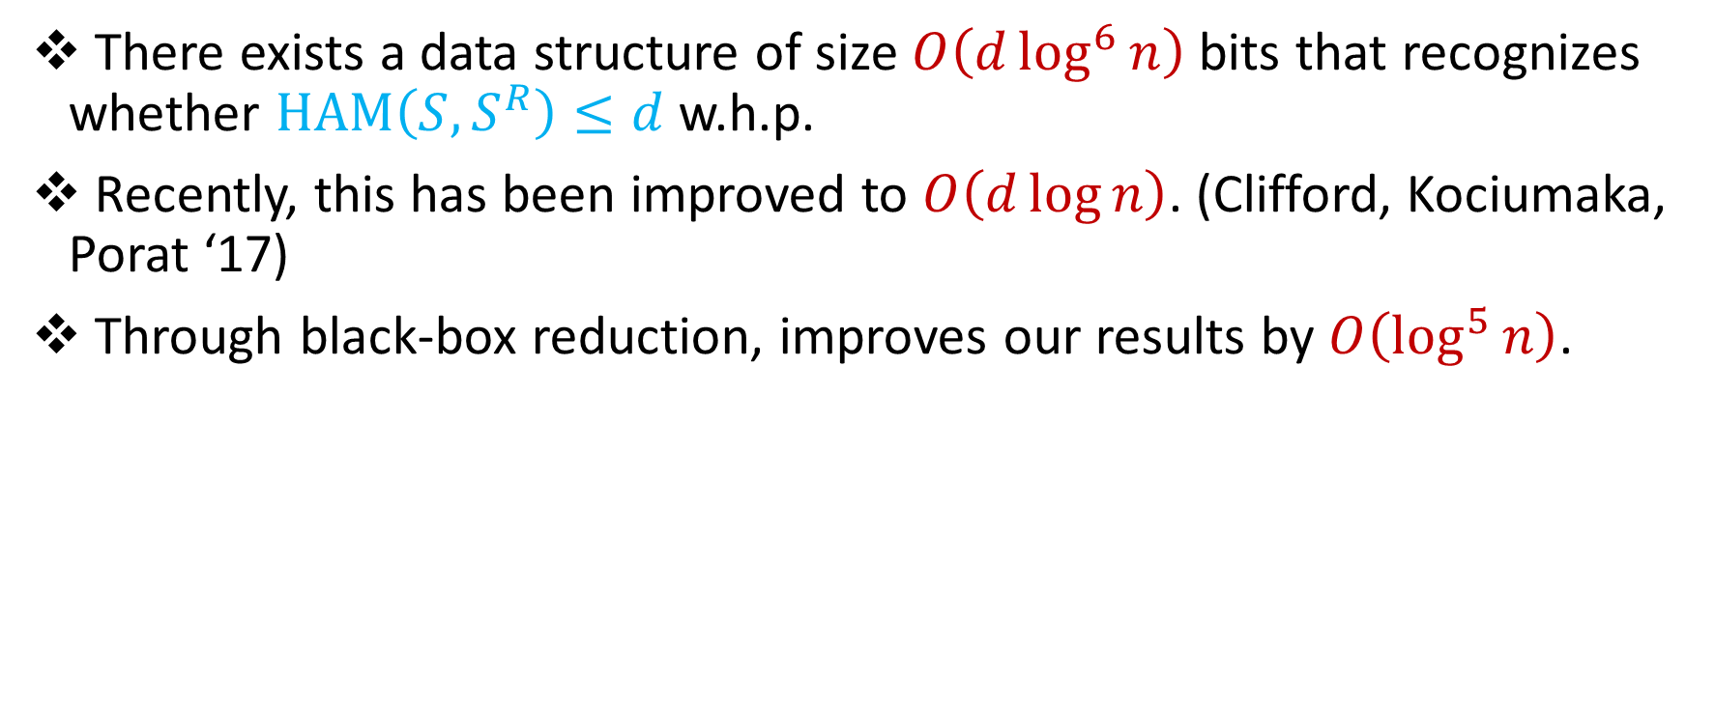
In Review
There exists a data structure of size $O\left(d\log^{6}{n}\right)$ bits that recognizes whether $HAM\left(S,S^{R}\right)≤d$ w.h.p.
Recently, this has been improved to $O\left(d\log{n}\right)$. (Clifford, Kociumaka, Porat ‘17)
Through black-box reduction, improves our results by $O\left(\log^{5}{n}\right)$.

Slide 30
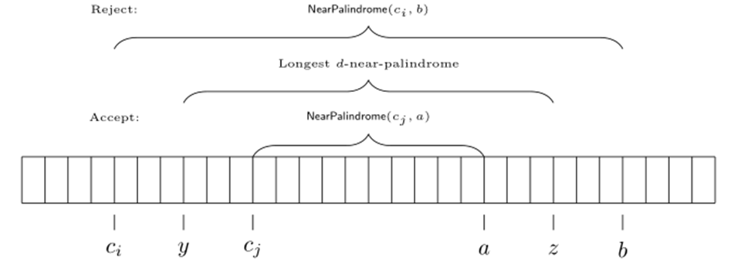

Additive Error Algorithm
Initialize a data structure every $\frac{\sqrt{n}}{2}$ positions!

Slide 31


Additive Error Algorithm
$2\sqrt{n}$sketches, each of size $O\left(d\log^{6}{n}\right)$ bits
Total space: $O\left(d\sqrt{n}\log^{6}{n}\right)$ bits

Slide 32
Structure of Talk
Background
1-Pass Additive Algorithm
2-Pass Exact Algorithm
Lower Bounds

Slide 33
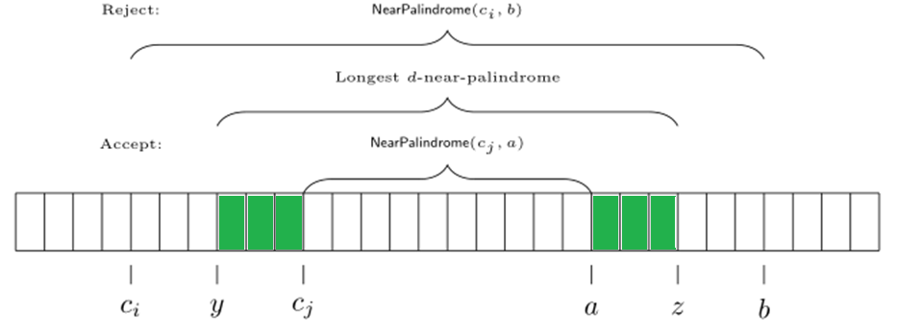
2-Pass Exact Algorithm
Can we modify 1-pass additive algorithm to 2-pass exact?
Missing characters before checkpoint!

Slide 34

2-Pass Exact Algorithm
Idea: keep all characters before each checkpoint in the second pass
What if there are $Ω\left(n\right)$ candidates?
Structural result of palindromes (BEMS14)

Slide 35
Structural Result of Near-Palindromes
Goal #1: Recover fingerprints of all overlapping “long” near-palindromes
Goal #2: Use sublinear space in compression

Slide 36
Structural Result of Near-Palindromes
Goal #1: Recover fingerprints of all overlapping “long” near-palindromes
Goal #2: Use sublinear space in compression

Slide 37
Structural Result of Near-Palindromes
Goal #1: Recover fingerprints of all overlapping “long” near-palindromes
Goal #2: Use sublinear space in compression

Slide 38
Structural Result of Near-Palindromes
Goal #1: Recover fingerprints of all overlapping “long” near-palindromes
Goal #2: Use sublinear space in compression

Slide 39
Structural Result of Near-Palindromes
Goal #1: Recover fingerprints of all overlapping “long” near-palindromes
Goal #2: Use sublinear space in compression

Slide 40
Structural Result of Near-Palindromes

Slide 41
Structural Result of Near-Palindromes
Goal #1: Recover fingerprints of all overlapping “long” near-palindromes
Goal #2: Use sublinear space in compression

Slide 42

Structural Result of Near-Palindromes
Not quite periodic (at most $2d−1$ different words)
Need to save at most $2d−1$ fingerprints of words

Slide 43


2-Pass Exact Algorithm
First pass: $O\left(d^{2}\sqrt{n}\log^{6}{n}\right)$ bits
At most $2d−1$ fingerprints, each of size $O\left(d\log^{6}{n}\right)$ words
Need to save at $\sqrt{n}$ characters before $2d−1$ checkpoints: $O\left(d\sqrt{n}\right)$
Total space: $O\left(d^{2}\sqrt{n}\log^{6}{n}\right)$ bits

Slide 44
Structure of Talk
Background
1-Pass Additive Algorithm
2-Pass Exact Algorithm
Lower Bounds

Slide 45
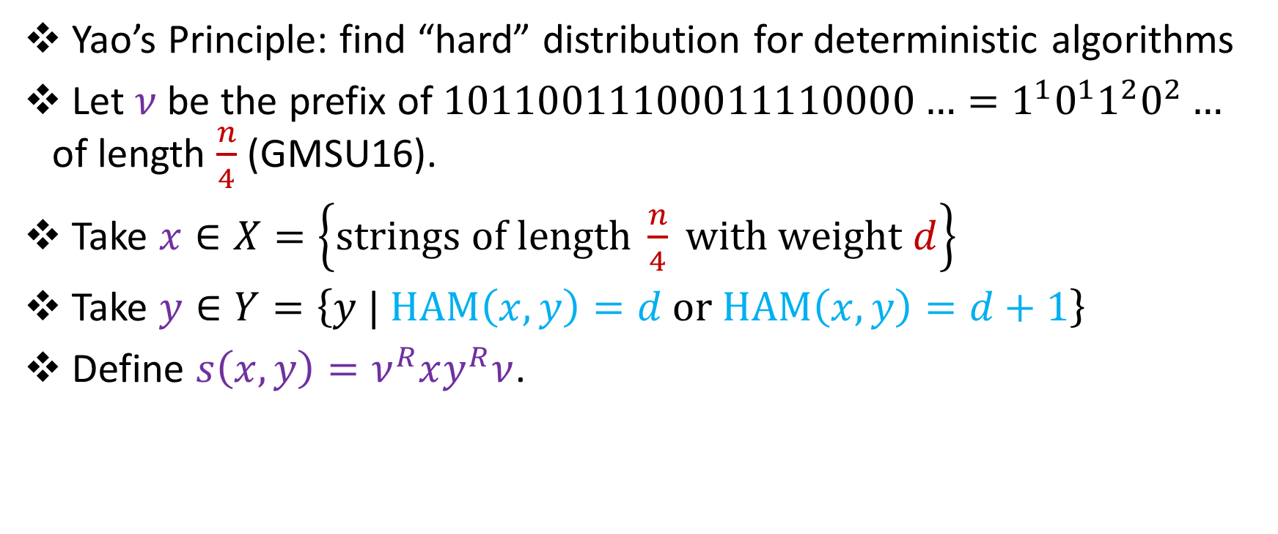
Multiplicative Lower Bounds
Yao’s Principle: find “hard” distribution for deterministic algorithms
Let $ν$ be the prefix of $10110011100011110000…=1^{1}0^{1}1^{2}0^{2}…$ of length $\frac{n}{4}$ (GMSU16).
Take $x∈X=\left\{strings of length \frac{n}{4} with weight d\right\}$
Take $y∈Y=\left\{y | HAM\left(x,y\right)=d or HAM\left(x,y\right)=d+1\right\}$
Define $s\left(x,y\right)=ν^{R}xy^{R}ν$.

Slide 46
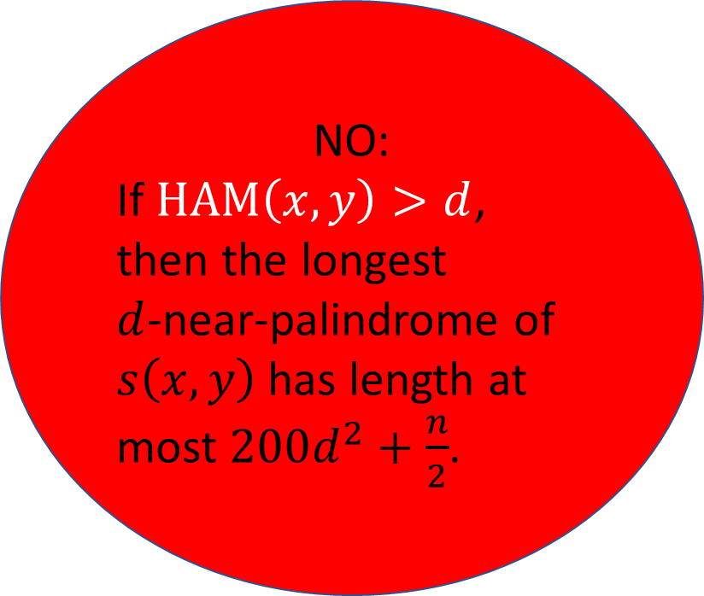
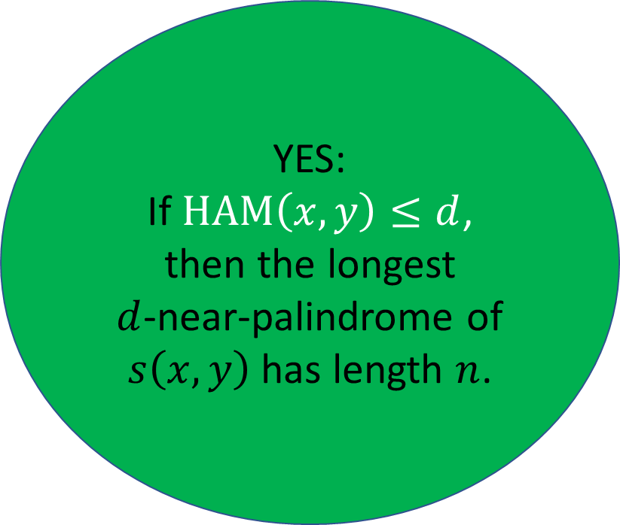
Multiplicative Lower Bounds
YES:
If $HAM\left(x,y\right)≤d$, then the longest
$d$-near-palindrome of $s\left(x,y\right)$ has length $n$.
NO:
If $HAM\left(x,y\right)>d$, then the longest
$d$-near-palindrome of $s\left(x,y\right)$ has length at most $200d^{2}+\frac{n}{2}$.

Slide 47

Multiplicative Lower Bounds
A $\left(1+ε\right)$ multiplicative algorithm differentiates whether $HAM\left(x,y\right)≤d$ or $HAM\left(x,y\right)>d$.
Just need to show cannot differentiate whether $HAM\left(x,y\right)≤d$ or $HAM\left(x,y\right)>d$ in $o(d\log{n)}$ space!

Slide 48


Multiplicative Lower Bounds
Save $x$ in $\frac{d\log{n}}{3}$ bits.
Since $x∈X=\left\{strings of length \frac{n}{4} with weight d\right\}$, there are $\frac{|X|}{4}$ pairs $(x,x^{′})$ which are mapped to the same configuration.

Slide 49
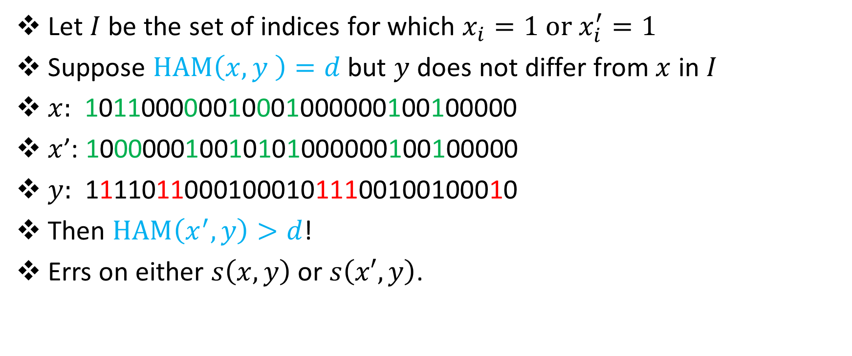
Multiplicative Lower Bounds
Let $I$ be the set of indices for which $x_{i}=1 or x_{i}^{′}=1$
Suppose $HAM\left(x,y \right)=d$ but $y$ does not differ from $x$ in $I$
$x:$ 101100000010001000000100100000
$x$’: 100000010010101000000100100000
$y:$ 111101100010001011100100100010
Then $HAM\left(x^{′},y\right)>d$!
Errs on either $s\left(x,y\right)$ or $s\left(x′,y\right)$.
???

Slide 50


Multiplicative Lower Bounds
There are $\frac{|X|}{4}$ values of $x$ mapped to the wrong configuration, each with $\left({\frac{n}{4} − 2d \atop d}\right)$ values of $y$, where algorithm is incorrect.
Probability of failure:
$$\frac{\frac{|X|}{4}\left({\frac{n}{4} − 2d \atop d}\right)}{\left|X\right||Y|}≥\frac{1}{n}$$

Slide 51
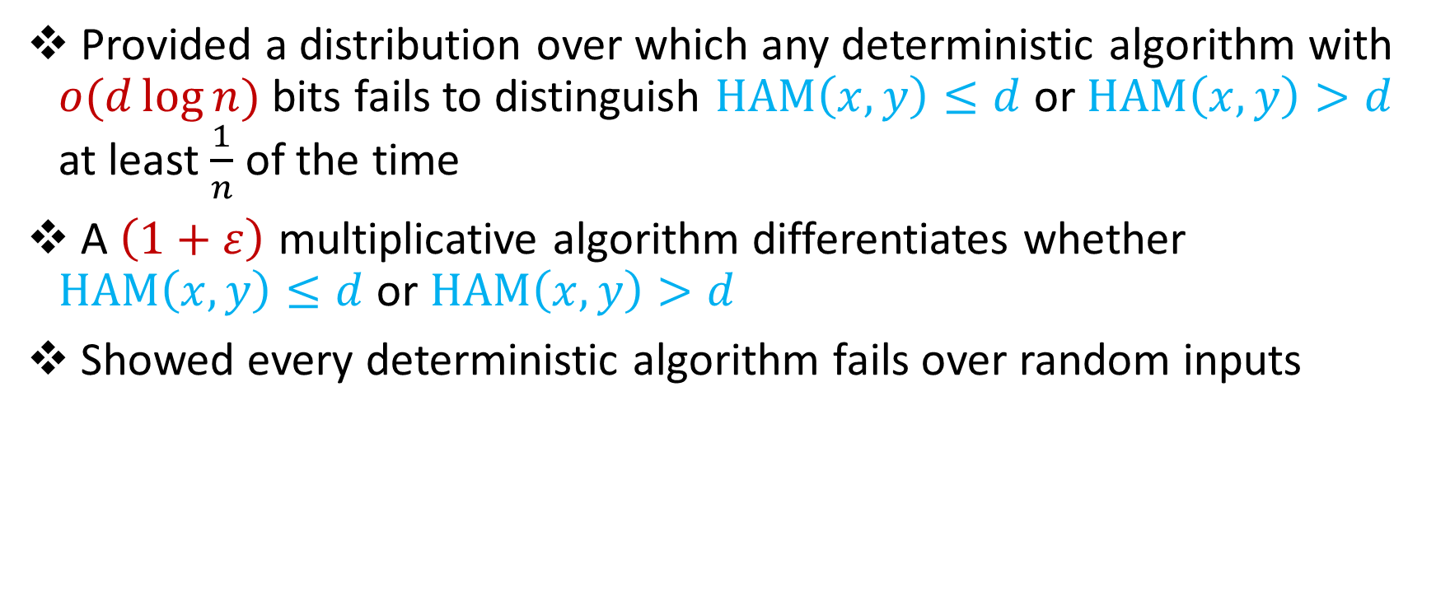
In Review
Provided a distribution over which any deterministic algorithm with $o(d\log{n)}$ bits fails to distinguish $HAM\left(x,y\right)≤d$ or $HAM\left(x,y\right)>d$ at least $\frac{1}{n}$ of the time
A $\left(1+ε\right)$ multiplicative algorithm differentiates whether $HAM\left(x,y\right)≤d$ or $HAM\left(x,y\right)>d$
Showed every deterministic algorithm fails over random inputs

Slide 52
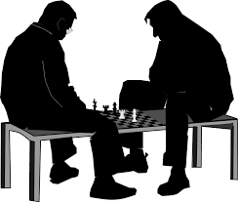

Additive Lower Bounds
Define $s\left(x,y\right)=1^{E}x_{1}1^{\frac{E}{d}}x_{2}1^{\frac{E}{d}}x_{3}…x_{\frac{n^{′}}{2}}y_{\frac{n^{′}}{2}}…y_{3}1^{\frac{E}{d}}y_{2}1^{\frac{E}{d}}y_{1}1^{E}$
Take $x∈X=\left\{all strings of length \frac{n^{′}}{2}\right\}$
Take $y∈Y=\left\{HAM\left(x,y\right)=d or HAM\left(x,y\right)=d+1\right\}$

Slide 53

Open Problems
Can we find the longest $d$-near-palindrome in the edit distance?
Longest palindromic subsequence

Slide 54


Slide 55

Questions?

